Slide 1
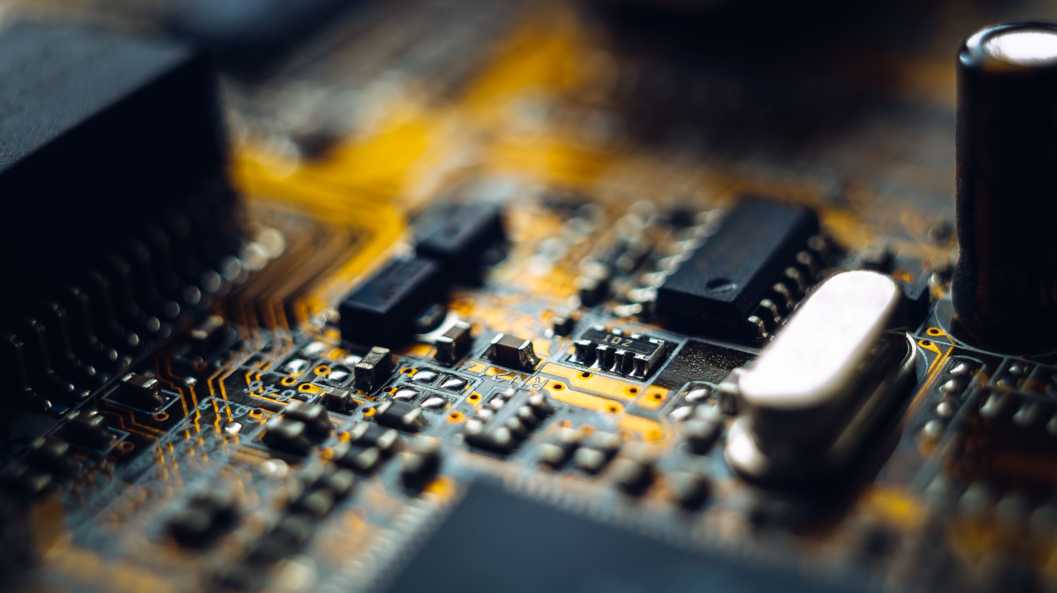
RSIP CAREER BASIC ML 001

Slide 2
TELECOM CUSTOMER CHURN PREDICTION USING WATSON AUTO AI
Team Members:
Deepak Kumar Rai
Jatin Gupta
Jnaneshwar

Slide 3
Project Description
Customer churn is a major problem and one of the most important concerns for large companies. Due to the direct effect on the revenues of the companies, especially in the telecom field, companies are seeking to develop means to predict potential customer to churn. Therefore, finding factors that increase customer churn is important to take necessary actions to reduce this churn. Churn prediction helps in identifying those customers who are likely to leave a company. The main contribution of our work is to develop a churn prediction model which assists telecom operators to predict customers who are most likely subject to churn. The model developed in this work uses machine learning techniques on IBM platform and builds a new way of features’ engineering and selection.

Slide 4
Solution
Telecommunication industry always suffers from a very high churn rates when one industry offers a better plan than the previous there is a high possibility of the customer churning from the present due to a better plan in such a scenario it is very difficult to avoid losses but through prediction we can keep it to a minimal level. We are building a Machine Learning model to predict the customer churn using IBM Watson AutoAI Machine Learning Service. The model is deployed on IBM cloud to get scoring end point which can be used as API in mobile app or web app building. We are developing a web application which is built using node red service. We make use of the scoring end point to give user input values to the deployed model. The model prediction is then showcased on User Interface.

Slide 5
Data Collection
For this project we use the Churn Prediction Dataset present on Kaggle. This dataset contains information related to 1000 customers link to a telecom company. The dataset is available on:
classification data set
https://www.kaggle.com/shrutimechlearn/churn-modelling

Slide 6
IBM CLOUD
IBM cloud computing is a set of cloud computing services for business offered by the information technology company IBM. IBM Cloud includes infrastructure as a service (IaaS), software as a service (SaaS) and platform as a service (PaaS) offered through public, private and hybrid cloud delivery models, in addition to the components that make up those clouds.

Slide 7
IBM WATSON STUDIO
IBM Watson Studio helps data scientists and analysts prepare data and build models at scale across any cloud. With its open, flexible multi cloud architecture, Watson Studio provides capabilities that empower businesses to simplify enterprise data science and AI, such as:
Automate AI lifecycle management with Auto AI
Visually prepare and build models with IBM SPSS Modeler
Build models using images with IBM Watson Visual Recognition and texts with IBM Watson Natural Language Classifier
Deploy and run models through one-click integration with IBM Watson Machine Learning
Manage and monitor models through integration with IBM Watson OpenScale

Slide 8
Steps for creating ML model
Create ML service
Create Project in Watson Studio
Auto AI Experiment In Add Environment
Setup Your Auto AI Environment
Import Dataset
Run The Model
Selection Of Auto AI Pipeline
Deploy And Test The Model In Watson Studio

Slide 9
Node Red
Node-RED is a flow-based development tool for visual programming developed originally by IBM for wiring together hardware devices, APIs and online services as part of the Internet of Things.
Node-RED provides a web browser-based flow editor, which can be used to create JavaScript functions. Elements of applications can be saved or shared for re-use. The runtime is built on Node.js. The flows created in Node-RED are stored using JSON. Since version 0.14, MQTT nodes can make properly configured TLS connections.
In 2016, IBM contributed Node-RED as an open source JS Foundation project.

Slide 10
Steps For Application Building
Create Node Red Service
Go To Manage Palette And Install Dashboard Nodes
Build UI With Node Red

Slide 11
Conclusion
The main purpose of the application is to build a Machine Learning model to predict the customer churn using IBM Watson Auto AI Machine Learning Service. The model is deployed on IBM cloud to get scoring end point which can be used as API in mobile app or web app building. We are developing a web application which is built using node red service. We make use of the scoring end point to give user input values to the deployed model. The model prediction is then showcased on User Interface.

Slide 12
Future Scope
Telephone service companies, Internet service providers, pay TV companies, insurance firms, and alarm monitoring services, often use customer attrition analysis and customer attrition rates as one of their key business metrics because the cost of retaining an existing customer is far less than acquiring a new one. Companies from these sectors often have customer service branches which attempt to win back defecting clients, because recovered long-term customers can be worth much more to a company than newly recruited clients. This can help companies in fetching information of active subscribers, collecting data and storing them.

Slide 13
Bibliography
Pavan Raj. “Telecom Customer Churn Prediction.” https://www.kaggle.com/pavanraj159/telecom-customer-churn-prediction
Quantzig. “Churn Analysis Solution Helps in Predicting Customer Satisfaction” https://www.businesswire.com/news/home/20170911005499/en/Churn-Analysis-Solution-Helps-Predicting-Customer-Satisfaction#:~:text=Predicting%20customers%20overall%20satisfaction%20as,predictive%20model%20and%20gathering%20data
www.wikipedia.org

